Slide 1

Types to the rescue!
Sebastian Rysztuń
October 24, 2018

Slide 2
Agenda
Types
  What
  Why
  How

Slide 3
Definition
type is an attribute of data which tells the compiler or interpreter how the programmer intends to use the data
we can group languages based on how they treat types
Notes:
Types alow us to specify how particular data should be treated and how we can use them

Slide 4
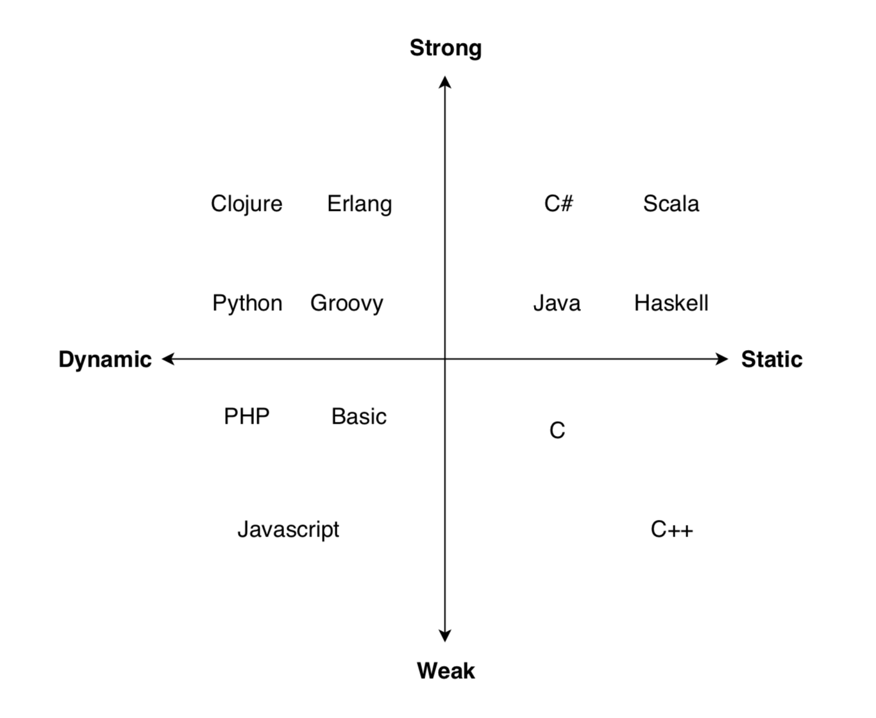
Static/Dynamic/Strong/Weak
Notes:
Static – types are chcecked durign compilation
Dynamic – typed are chceked in runtime
Weak – allows for implicite casting and conversions
Strong – you need to be strict with our types

Slide 5
Interpreter vs Compiler
Interpreter
convert code into machine code line by line when the program is run
all errors in runtime
Compiler
code will be parsed and analyzed
If no error -> conversion of source code to machine code
many errors are caught before runtime
Notes:
Each of approached has its benefits
- depends on use case you should choose appropiate style, not only „take this because I know it”

Slide 6
Types as flow control
Cyclomatic complexity
  number of paths through a particular piece of code
  More places where your program can end execution or it branches off you have, it is harder to understand it a.k.a. sphagetti code

Slide 7
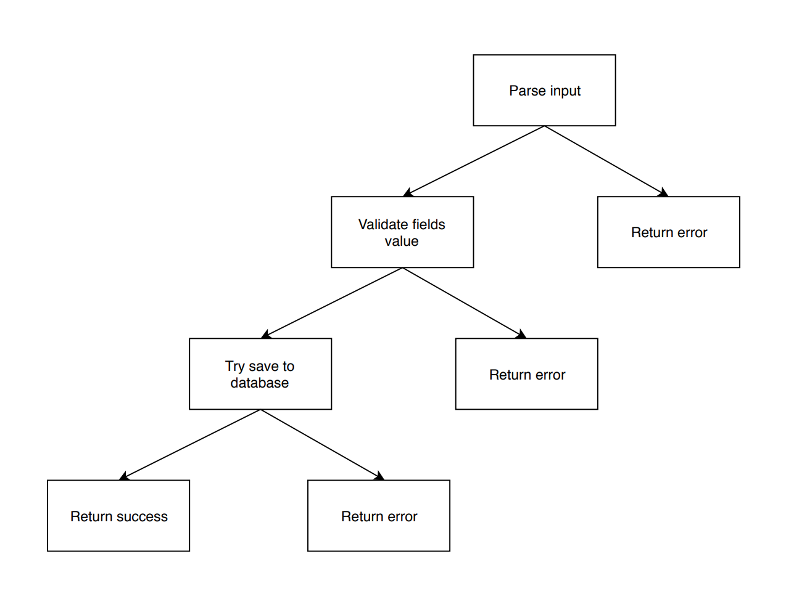
Types as flow control

Slide 8
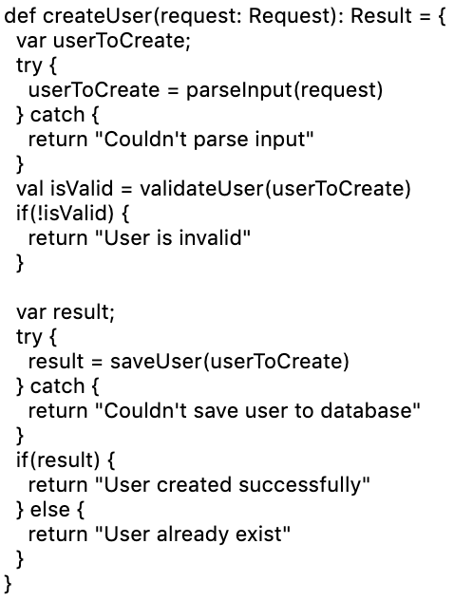
Types as flow control
Notes:
Lot of noise in the code + it is harder to understand
You need to keep in your head a lot of informations as code can return in many places

Slide 9
Types as flow control
Railway pattern
  functional approach to error handling
  two tracks
    happy path
    error stream

Slide 10
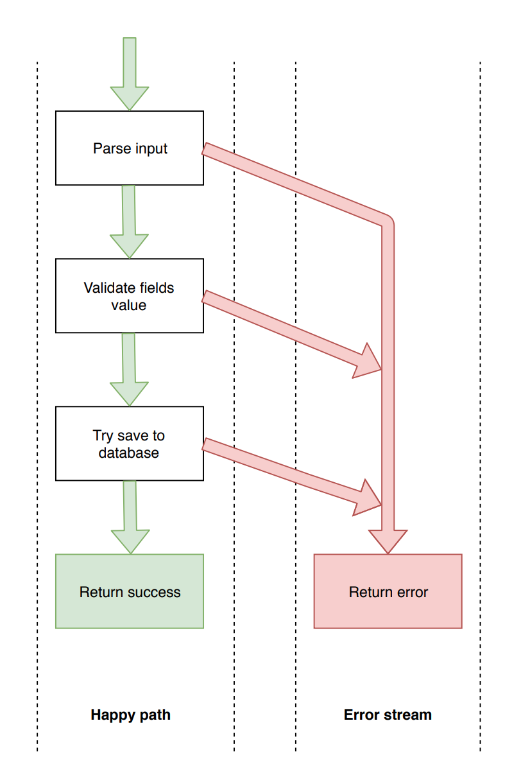
Types as flow control
Notes:
Sounds familiar? STDOUT, STDERR

Slide 11
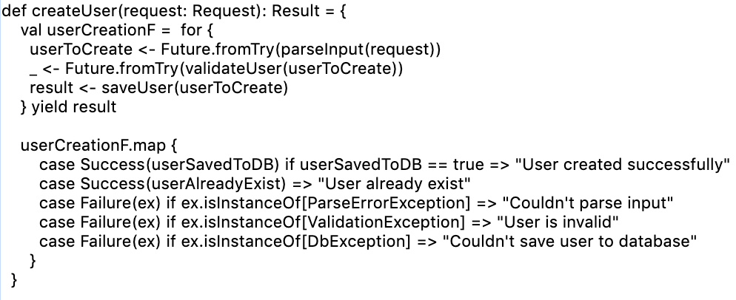
Types as flow control
Notes:
2 parts:
Declarative say what steps should be perfomed
In the end check if code finished on happy path or in error stream and handle result appropietly

Slide 12
Types as flow control
First version of code
Notes:
Ok so we now know how use types to model flow control
Lets try use types to model our domain

Slide 13
Types as domain description
String with name is something other that String with email
Too many primitive types – easier to make mistake
Data types/Value classes/Opaque data type
  https://docs.scala-lang.org/overviews/core/value-classes.html
Notes:
If type allow to store more than you would expect it is possible that somwhere in some point in the time someone will make mistake
Username: String, Surname: String -> very easy to swap values
Type all the things! … but what about runtime impact (additional boxing etc.) ?
Why not delegate this work to compiler and produce types that are used only on compile time and transparent during runtime to not create overhead?

Slide 14
Types as flow control
Second version of code
Notes:
As developers we’re bad in naming things
Documentation is very quickly outdated
What about use types as internal documentation

Slide 15
Types as documentation
Our type can describe precisely what is possible inside function
Compiler will keep an eye on us to keep it updated and truthfully
Notes:
If you don’t know from function return type that it is throwing exception you couldn’t be sure
Some examples of types that we can use

Slide 16

Types as documentation
We can return null? Use Option

Slide 17

Types as documentation
We can throw exception? Use Try

Slide 18
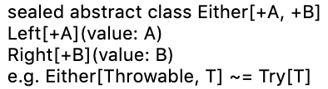
Types as documentation
We want to return one from the two types?
Use Either

Slide 19
Types as documentation
Third version of code
Notes:
Validation can throw
Connection to DB can throw

Slide 20
Types as documentation
What can be next?
  Throwing exception is heavy operation, we can get rid of Stack trace in many cases and use https://www.scala-lang.org/api/2.13.1/scala/util/control/NoStackTrace.html
  Why we need throw exceptions? We can use Either instead
  Separate declarative business logic from side effects and infrastracture (imperative code) e.g. Using Final Tagless approach to model our application

Slide 21
Types as documentation
We can go even further beyond, e.g. encode definition of our API as types
  Endpoints: https://github.com/julienrf/endpoints - defining communication protocols over HTTP between applications
  Tapir: https://github.com/softwaremill/tapir - describe HTTP API endpoints as immutable Scala values
Or encode mathematical ML calculation on type level:
  https://www.youtube.com/watch?v=BfaBeT0pRe0

Slide 22
Summary 1/2
the more things checked by compiler, the less things we need to check
richer and better IDE support during developement
more things compiler must do, more time compilation will take

Slide 23
Summary 2/2
"primitive types are not the proper types”
try avoid branching to make your code easier to understand – railway pattern
types are your best documentation
types are not for free, but ... are an investment that pays off in the long run

Slide 24
Questions?

Slide 25
Thank you!

